Slide 1
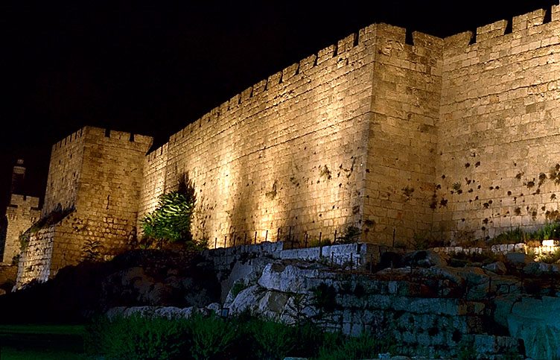
vUrNykpd; Gtpapay;
ghpRj;j efuk;
Dr. Rick Griffith, Singapore Bible College
BibleStudyDownloads.org

Slide 2

jw;Nghija cyfk;

Slide 3

etPdfhy kj;jpa fpof;F ehLfs;
9

Slide 4

,lg;gFjp
Guhjd ,];uNtypy; gazg;ghij
tyg;gFjp
Nkw;F> tlf;F
fpof;F> njw;F

Slide 5

vUrNyk;
21
gpujp$yk;
mD$yk;
gFjpfs;
Kf;fpaj;Jtk;

Slide 6
vUrNyk;
21
gpujp$yk;

Slide 7
,lg;gFjp
Guhjd ,];uNtypy; gazg;ghij
tyg;gFjp
12

Slide 8
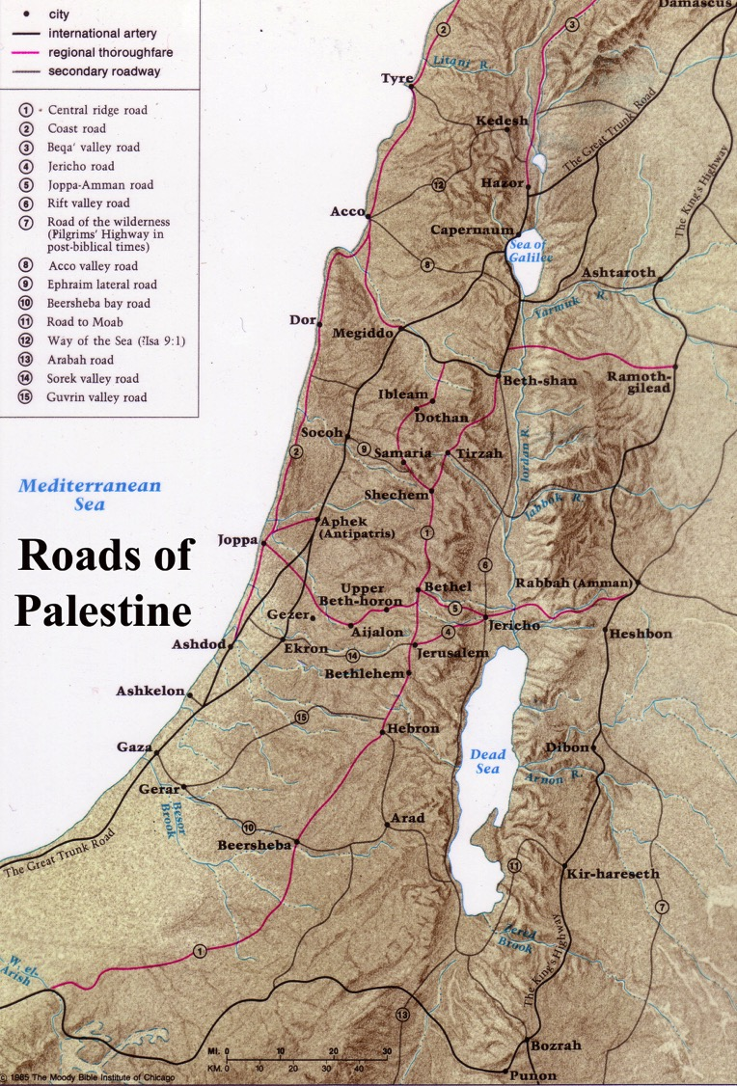
vUrNyk; gpujhd ghijapy; ,Ue;J xJq;fp ,Uj;jy;
12
Roads of Israel
Beitzel, Moody Atlas of Bible Lands, 68

Slide 9
vUrNyk;
21
gpujp$yk;
mD$yk;

Slide 10
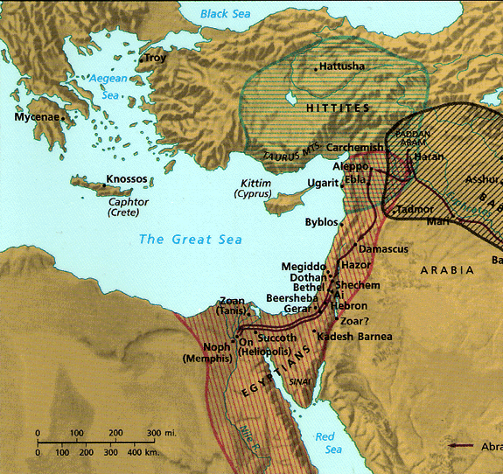
vUrNyk; %Nyhgha miktplk;
9
rpe;jidf;Nfs;tp
vt;thW Njtd; vk;ik jkJ Nehf;fj;jpw;F mikthd %Nyhgha ,lj;jpy; itj;Js;shh;?
“fh;j;juhfpa Mz;lth; nrhy;YfpwJ vd;dntd;why;> ,JNt vUrNyk;> Gw[hjpfspd; eLtpNy ehd; mij itj;Njd;> mijr; Rw;wpYk; Njrq;fs; ,Uf;fpwJ.”
vNrf;fpNay; 5:5

Slide 11
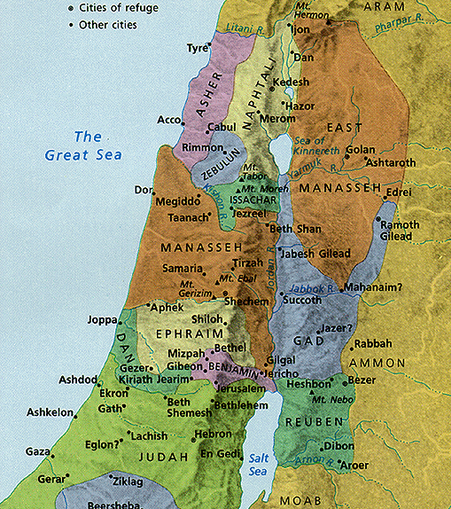
kj;jpa miktplk;
14
vUrNyk; ,];uNtypd; “njhg;G+s; vd mwpag;gl;lJ”
vUrNyk;
Notes:
Some say Jerusalem was in the “navel” of Israel, meaning the center!

Slide 12
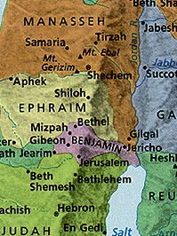
kj;jpa miktplk;
14
vUrNyk; ngd;akPdpy; A+jhtpw;F mLj;jjhfTk;; Mdhy; tl Nfhj;jpuq;fSf;F mUfhikapYk; cs;sJ
n[UrNyk;
Notes:
12
Some say Jerusalem was in the “navel” of Israel, meaning the center!

Slide 13
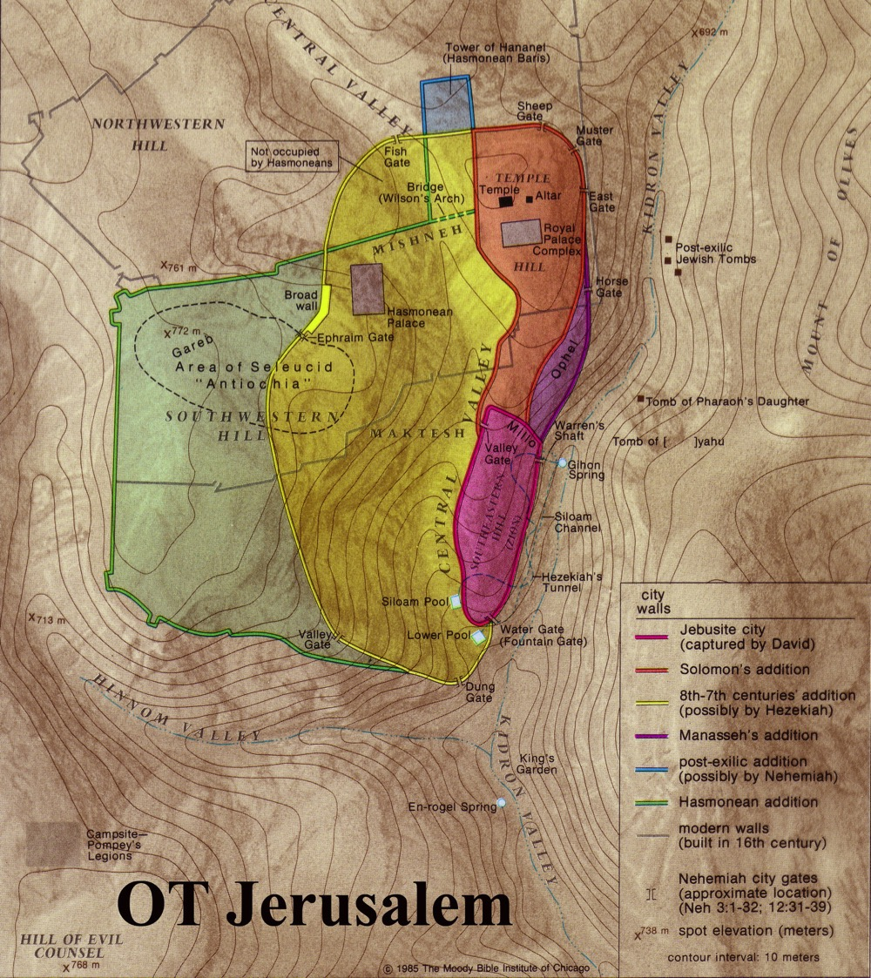
vUrNyk; vy;iy efukha; fhzg;gl;lJ
23
A+jh> ngd;akPd; vy;iyfshf njd;gFjp kl;Lk; fle;J nry;fpd;wJ
ngd;akPd;
A+jh

Slide 14
vUrNyk;
20
gpujp$yk;
mD$yk;
ghJfhf;Fk; gs;sjhf;Ffs;
ijNuhgPd;
fpd;Ndhk;
nfjNuhd;
ijNuhgPd; gs;sjhf;F
fpjNuhd; gs;sjhf;F
fpd;Ndhk; gs;sjhf;F

Slide 15
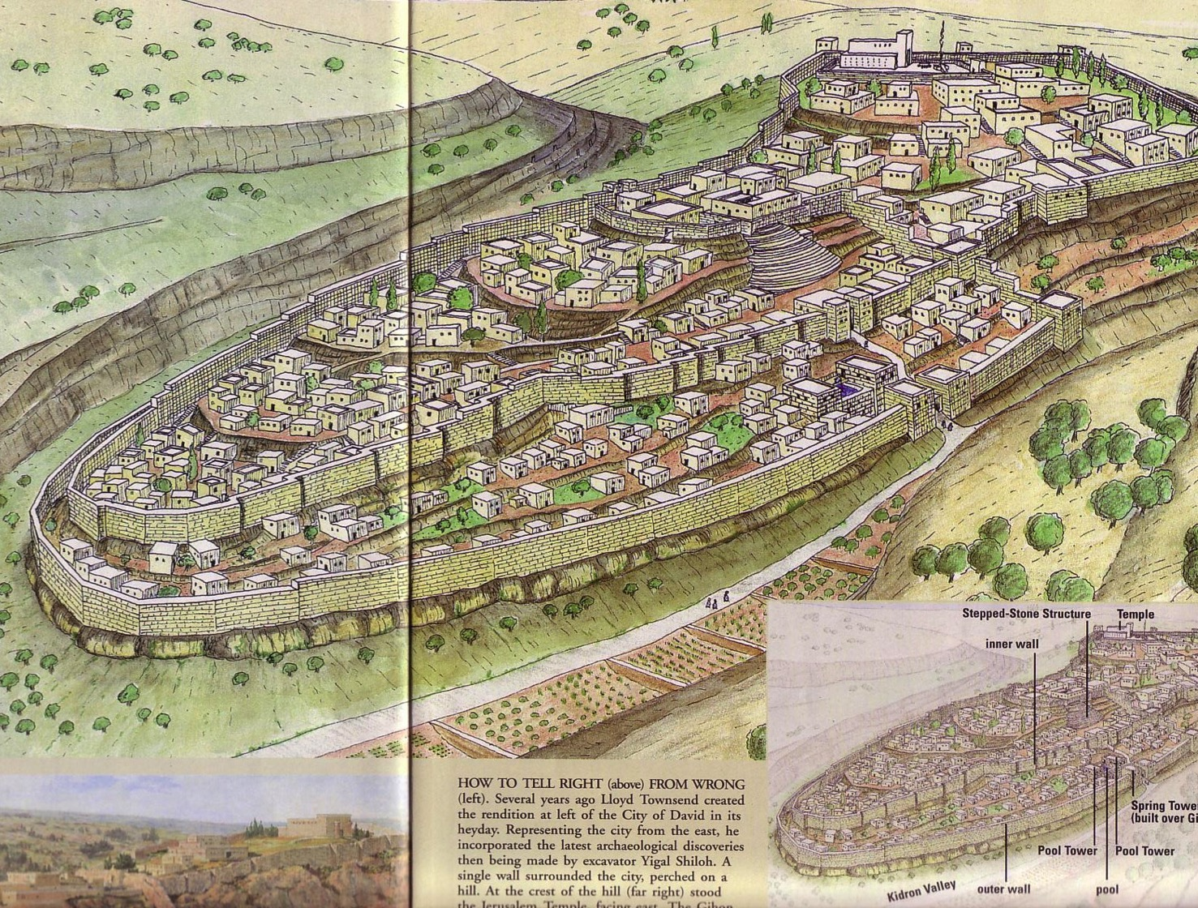
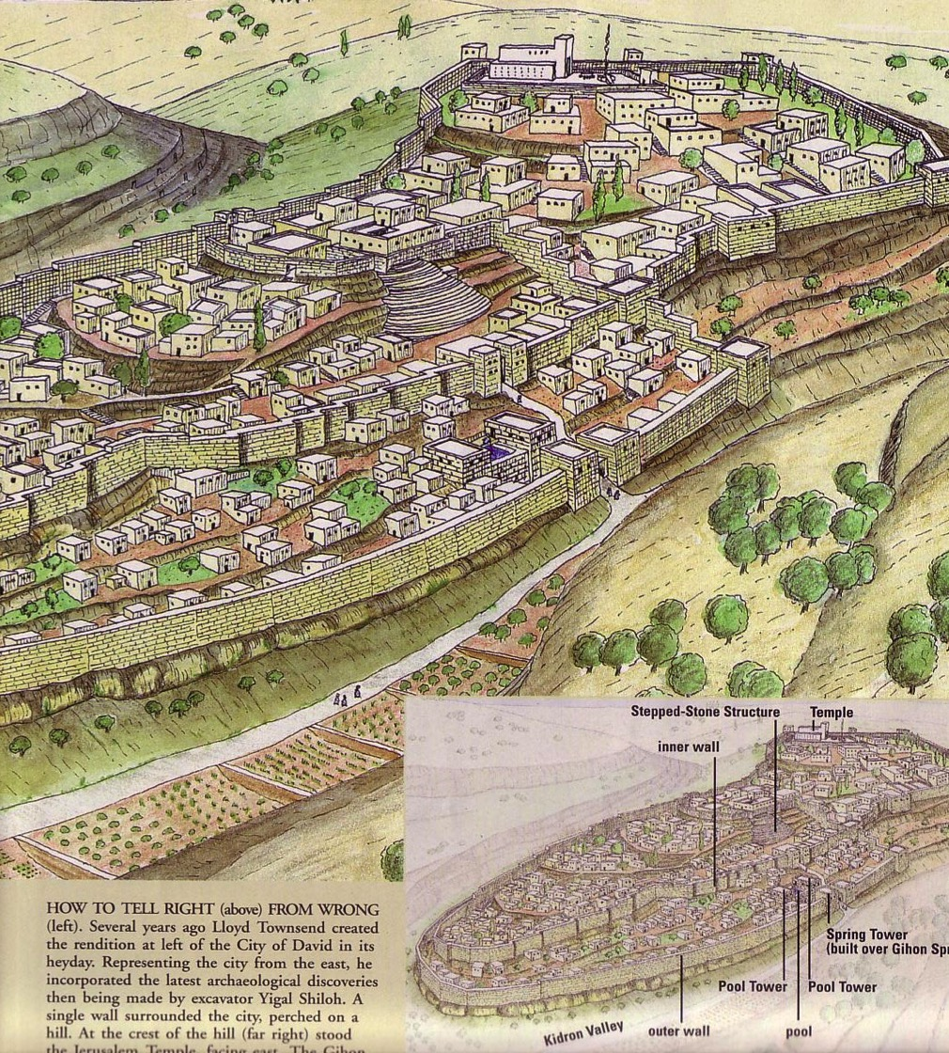
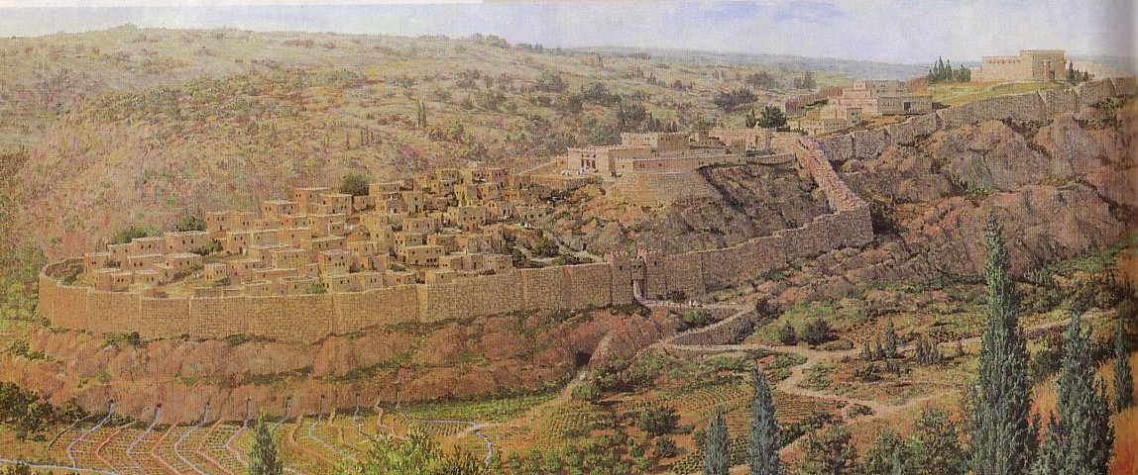
jhtPjpd; fpof;F efuk;
“mtd; jpld;nfhz;L> ,be;JNghd kjpiynay;yhk; fl;b> mitfisAk; ntspapYs;s kw;w kjpiyAk; nfhj;jsq;fs;kl;Lk; cah;j;jp> jhtPJ efuj;jpd; Nfhl;iliag; gyg;gLj;jp> jpushd MAjq;fisAk; Nflfq;fisAk; gz;zp> 2ehsh. 32:5)
24d
“gpd;G mtd; jhtPJila efuj;jpd; ntsp myq;fj;ijf; fPNahDf;F Nkw;NfapUf;fpw gs;sj;jhf;F njhlq;fp kPd;thry;kl;Lk; fl;b> XNgiyr; Rw;wpYk; mij tisj;J> mij kpfTk; cah;j;jp> a+jhtpYs;s muzhd gl;lzq;fspnyy;yhk; ,uhZtj;jiytiu itj;J> 2ehsh. 33:14)

Slide 16
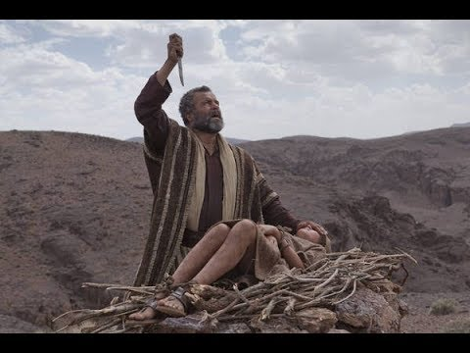
Mjpahfkk; 22
Why did God ask Abraham to sacrifice Isaac?

Slide 17
vUrNyk;
21
gpujp$yk;
mD$yk;
ghJfhf;Fk; Fd;Wfs;
ePh; epiyfs;

Slide 18
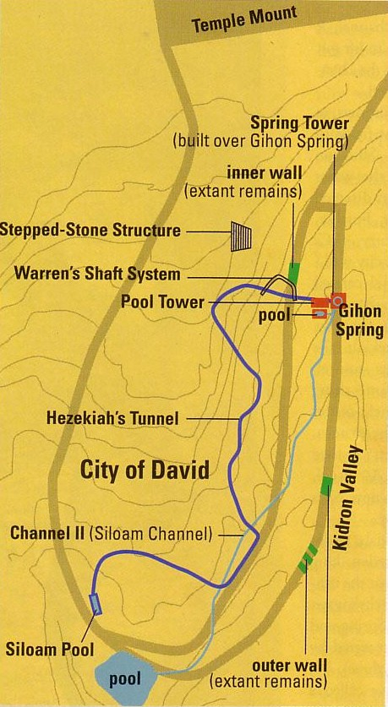

nfNrf;fpahtpd; Ruq;fk;
24e

Slide 19

nfNrf;fpahtpd; Ruq;fk;
24e
rpNyhk; fy;ntl;L

Slide 20
rpNyhk; fy;ntl;L
24e
“(…..vg;nghOJ) (me;j fhy;tha;) ClWj;jpUe;jJ. mj;Jld; mJ ,e;j topf;$lhfNt ntl;lg;gl;bUe;jJ.: mg;nghOJ (…) (,Ue;jJ) mg;gbNa (…) Nfhlhp(fs;)> xt;nthU kdpjDk; mLj;j kdpjid njhlh;e;J ,Uf;Fk; NghJ> ,d;Dk; %d;W Kok; ntl;lNtz;b ,Ue;j NghJ> (mq;Nf Nfl;lJ) xUkdpjdpd; rj;jk; gpd;njhlUgtDf;F Nfl;lJ> mq;Nf xU xd;Nuhnlhd;W Nky; nghUe;Jk; ,lk; fy;ypd; tyg;gFjpapy; fhzg;gl;lJ (,lg;gFjpapYk;). Fifapy; Ntiy nra;Ak; kdpjDf;F Nfl;lJ jd;id gpd;gw;Wtdpd; Nfhlhhp rj;jKk; vjpNu Ntiy nra;Ak; kdpjdpd; Nfhlhhp rj;jKk;: jz;zPuhdJ 1200 Koj;Juj;jpy; cs;s Cw;wpy; ,Ue;J ePh; Njf;fj;jpw;W fle;J te;jJ mj;Jld; fy;ypd; caukhdJ Fifapy; Ntiy nra;Ak; kdpjdpd; Nky; 100 Kokhf fhzg;gl;lJ.

Slide 21
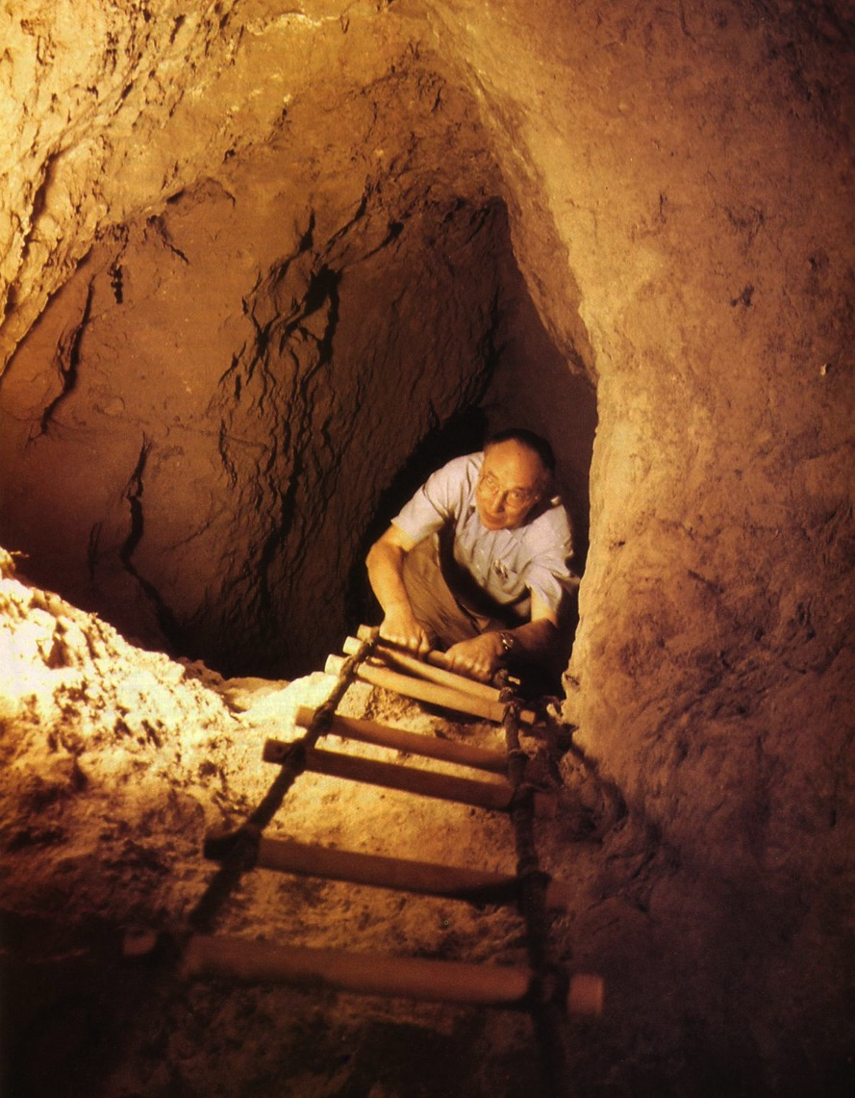
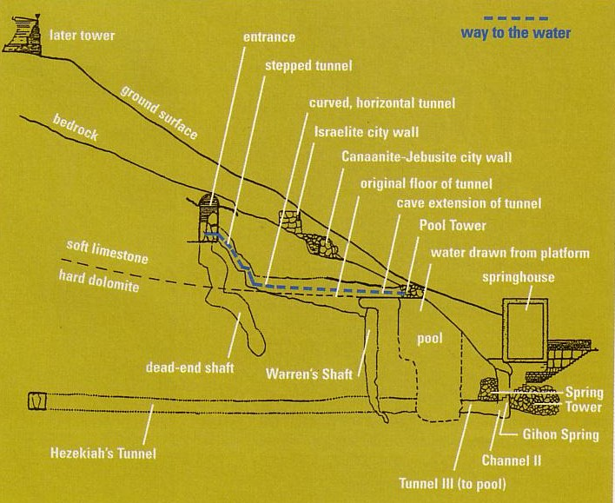
tuhd; Nfhy;
24c
Warren's Shaft
Notes:
BAR Nov/Dec 1999

Slide 22
vUrNyk;
23
gpujp$yk;
mD$yk;
gFjpfs;
vG+rpah; (1500 fp.K.)

Slide 23
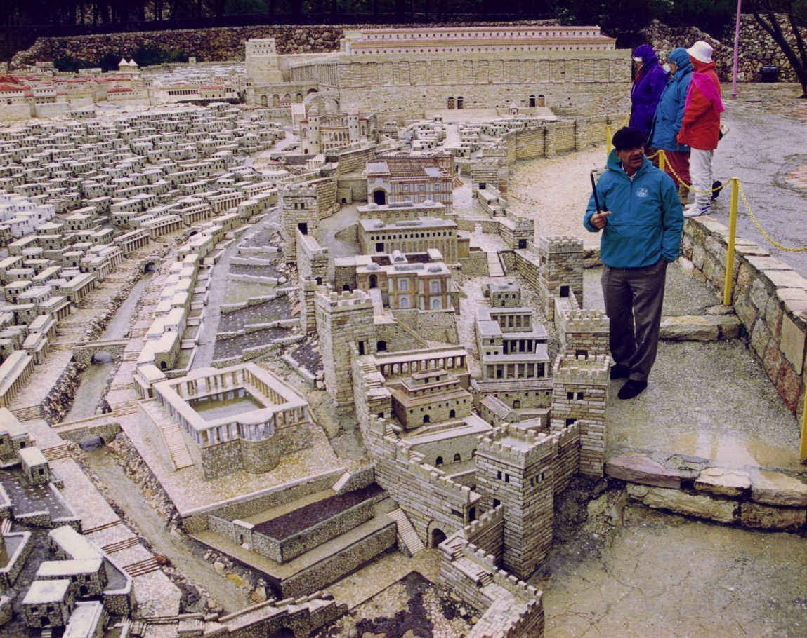
jhtPjpd; efuj;jpd; khjphp (fp.gp. 66)
(Guhjd vG+rpah; kPs;fl;Lkhdk;)
23

Slide 24
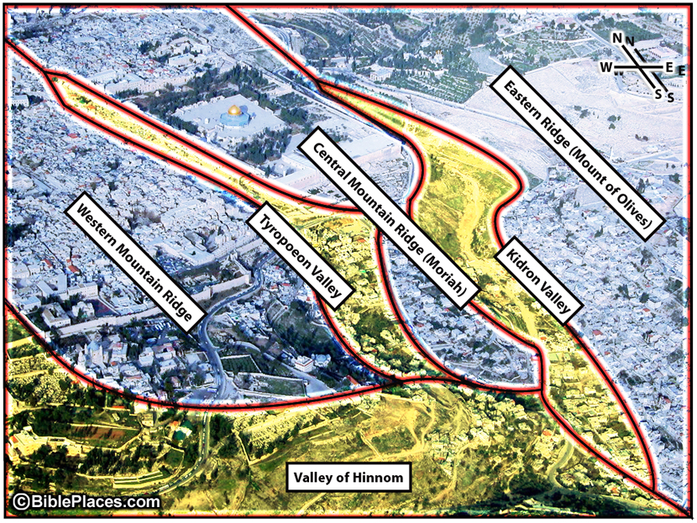
vUrNyk; gs;sj;jhf;FfSk; KfLfSk;
fpof;F KfLfs; (xypt kiy)
kj;jpa kiy KfL
nfjNuhd; gs;sj;jhf;F
Nkw;F kiy KfLfs;
ijNuhg;gpad;; gs;sj;jhf;F
ஹினோம் பள்ளத்தாக்கு

Slide 25
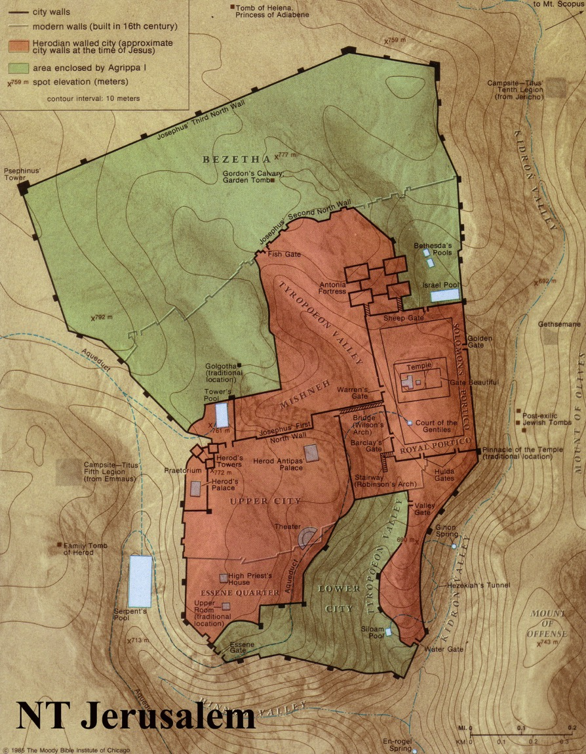
vUrNykpd; Fd;Wfs;
24
tlfpof;F
Njthyak;
xg;ghy;(Xngy;)
Nky; efuk;
fPo; efuk;
Gjpa Vw;ghl;L vUrNyk;

Slide 26
vUrNyk;
23
gpujp$yk;
mD$yk;
gFjpfs;;
vG+rpah; (1500 fp.K.)
rhyNkhd; (971 fp.K)
vNrf;fpah (700 fp.K)
vNrf;fpah(700 fp.K)
586 fp.K.
neNfkpah (444 fp.K)
f];Nkhdpah; (100 fp.K)
kfh VNuhJ (20 fp.K.)
etPd kjpy;

Slide 27
23
vUrNyk;
gpujp$yk;
mD$yk;
gFjpfs;;
Kf;fpaj;Jtk;
A+jh;
fpwp];jth;fs;
,];yhkpau;
vy;yh ehLfSk;

Slide 28
gpw Njrq;fis Fwpj;J ,];uNtypd; vz;zg;ghL vd;d?
Readings From the First-Century World, 23
Notes:
Elwood & Yarbrough, Readings from the First Century World, 23

Slide 29
gpw Njrq;fis Fwpj;J ,];uNtypd; vz;zg;ghL vd;d?
,];Nuy; vjpu; gpw ehLfs;
“vy;yh ehLfspYk; ,];Nuy; ghpRj;j ehlhf fhzg;gLtjpdhy; mq;F gj;J tpjkhd ghpRj;jepiyfs; fhzg;gLfpd;wJ. ,jdhy; mth;fs; Kjy; fdpfisAk; ,uz;L mg;gq;fisAk; nfhz;L tUthh;fs;.”
10MtJ kfh ghpRj;j gpuNjrk;
Notes:
Elwood & Yarbrough, Readings from the First Century World, 23

Slide 30
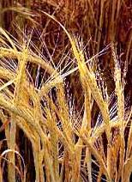
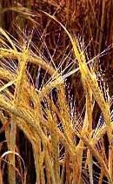
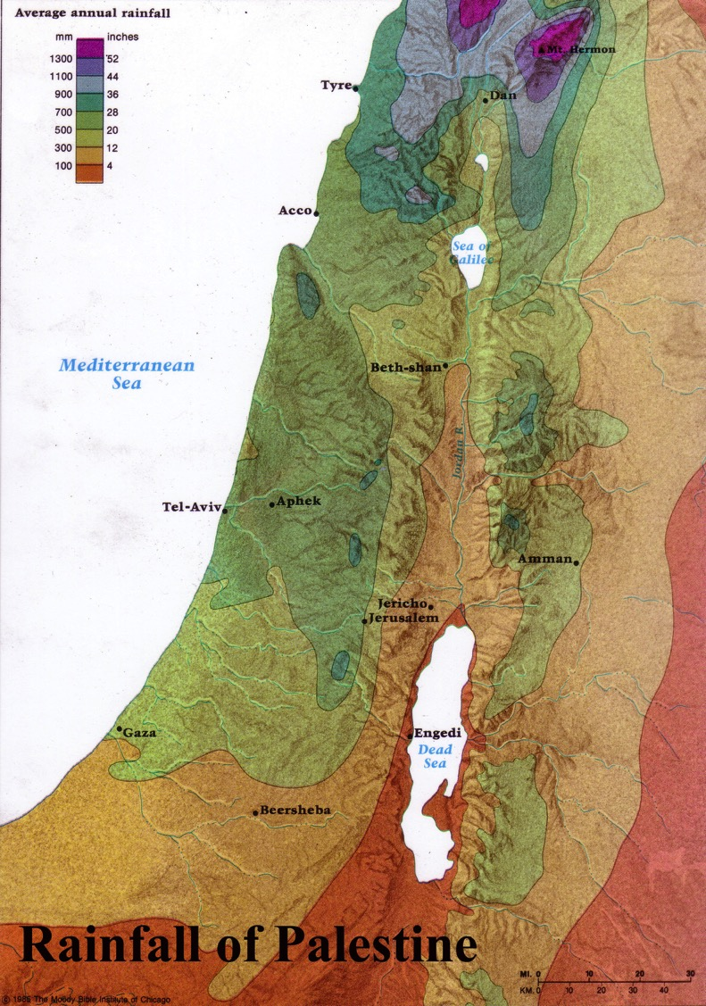
Kjw;fdp: mirthl;Lk; fhzpf;if
,];Nuypd; tlf;fpd; JhugpuNjrq;fspy; ,Ue;jhd mWtil
vUrNykpw;F nfhz;LtUjy;
Beitzel, Moody Atlas of Bible Lands, 50

Slide 31
efuk; vjph; fpuhkk;
gpw Njrq;fis Fwpj;J ,];uNtypd; vz;zg;ghL vd;d?
kjpy;fis nfhz;l efuq;fs; jw;NghJk; kfh ghpRj;jkhditfs; mjpy; fhzg;gl;l F\;lNuhfpfis gpw gpuNjrq;fSf;F mDg;gptpLthh;fs;
9MtJ kfh ghpRj;j ,lk;
Notes:
Mishnah Tractate Kelim 1.6-9 in Elwood & Yarbrough, Readings from the First Century World, 23

Slide 32
vUrNyk; vjph; gpw efuq;fs;
gpw Njrq;fis Fwpj;J ,];uNtypd; vz;zg;ghL vd;d?
“ghpRj;jkhd czTfis mth;fs; khj;jpuk; vUrNykpd; kjpy;fspw;Fs;shf cz;ghh;fs;. mt;tplk; kfh ghpRj;jkhdJ"
vUrNyk;
8MtJ kfh ghpRj;j ,lk;
Notes:
Mishnah Tractate Kelim 1.6-9 in Elwood & Yarbrough, Readings from the First Century World, 23

Slide 33
Temple Mount
gpw Njrq;fis Fwpj;J ,];uNtypd; vz;zg;ghL vd;d?
Mya Fd;W vjph; gpw gFjpfs;.
“;gsf;];(flux) cilath;fs; khjtplha; gps;is NgWfhy ngz;fs; cl;nry;y mDkjpf;fglkhl;lhh;fs;”
7MtJ kfh ghpRj;j ,lk;
Notes:
Mishnah Tractate Kelim 1.6-9 in Elwood & Yarbrough, Readings from the First Century World, 23

Slide 34
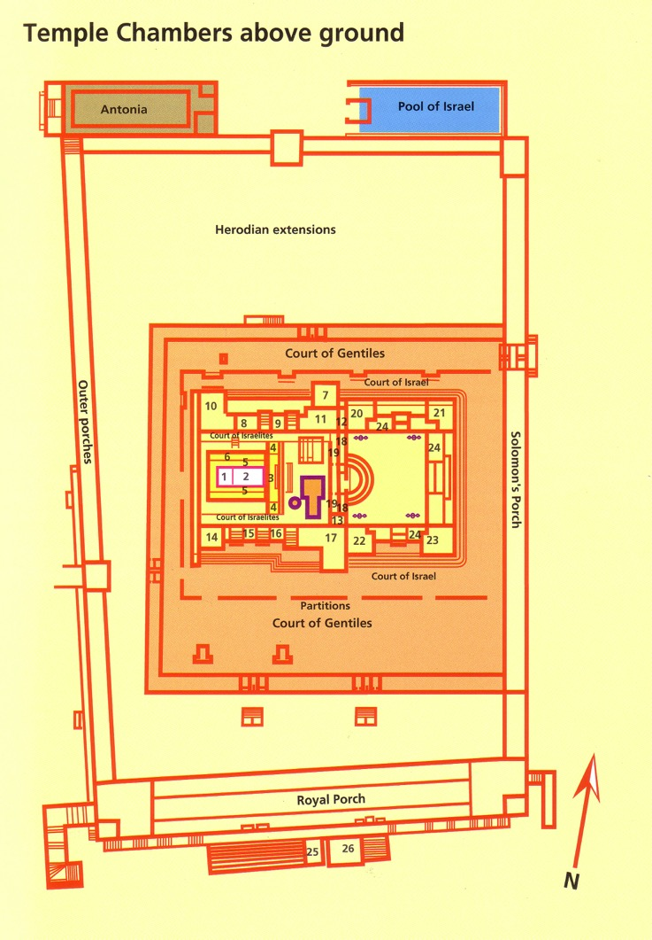
The Rampart
gpw Njrq;fis Fwpj;J ,];uNtypd; vz;zg;ghL vd;d?
ghJfhg;G muz; vjph; Mya Fd;wpd; kpFjp gFjpfs;
“Gw[hjpfSk; gpzj;ij njhl;ljpdhy; jPl;lhdth;fSk; cl;nry;y KbahJ”
6MtJ kfh ghpRj;j ,lk;
Notes:
Mishnah Tractate Kelim 1.6-9 in Elwood & Yarbrough, Readings from the First Century World, 23

Slide 35
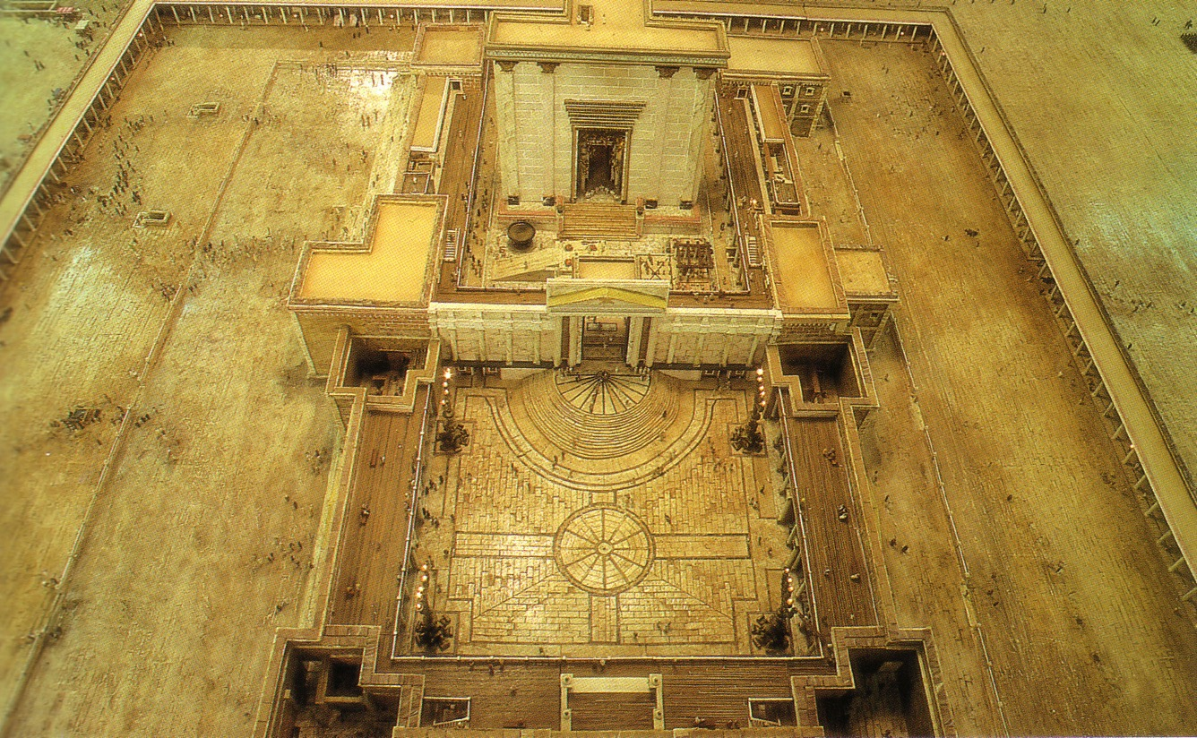
Court of Women
gpw Njrq;fis Fwpj;J ,];uNtypd; vz;zg;ghL vd;d?
ngz;fSf;fhf xJf;fg;gl;l ,lk;
ngz;fSf;Fk; jq;fis mNj ehspy; Rj;jpfhpj;j Mz;fSf;Fkhd ,lk;.
Mrhhpah;
,];uNayh;
ngz;fs;? Gw[hjpahh;?
,];uNayh;
5MtJ kfh ghpRj;j ,lk;
Notes:
Mishnah Tractate Kelim 1.6-9 in Elwood & Yarbrough, Readings from the First Century World, 23

Slide 36
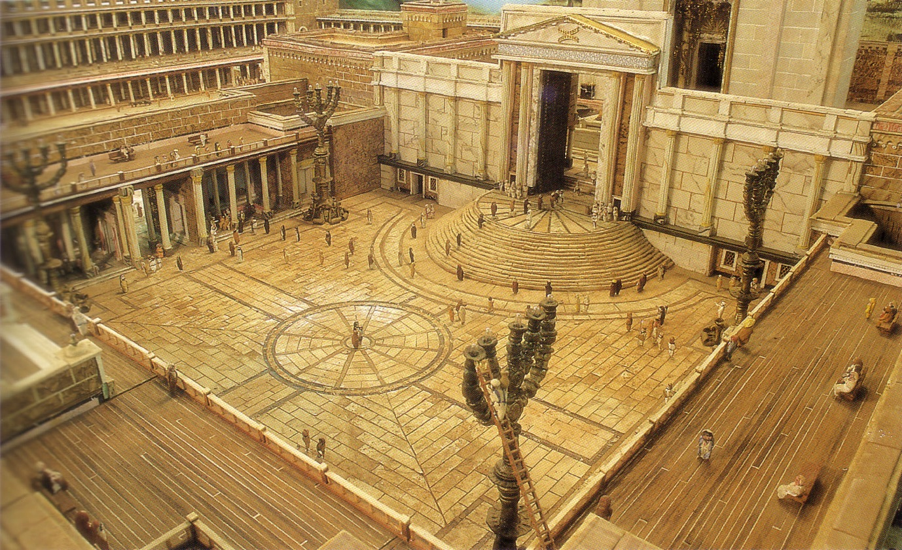
Court of Israelites
A+j gpuNjrj;jpy; gj;J ghpRj;j epiyfs;
,];uNayh;; kz;lgk;
gpuharpj;jk; nra;j Mz;fs; khj;jpuk; nry;y KbAk; my;yJ ght epthuzgyp nrYj;j Ntz;Lk;.
4MtJ kfh ghpRj;j ,lk;
Notes:
Mishnah Tractate Kelim 1.6-9 in Elwood & Yarbrough, Readings from the First Century World, 23

Slide 37
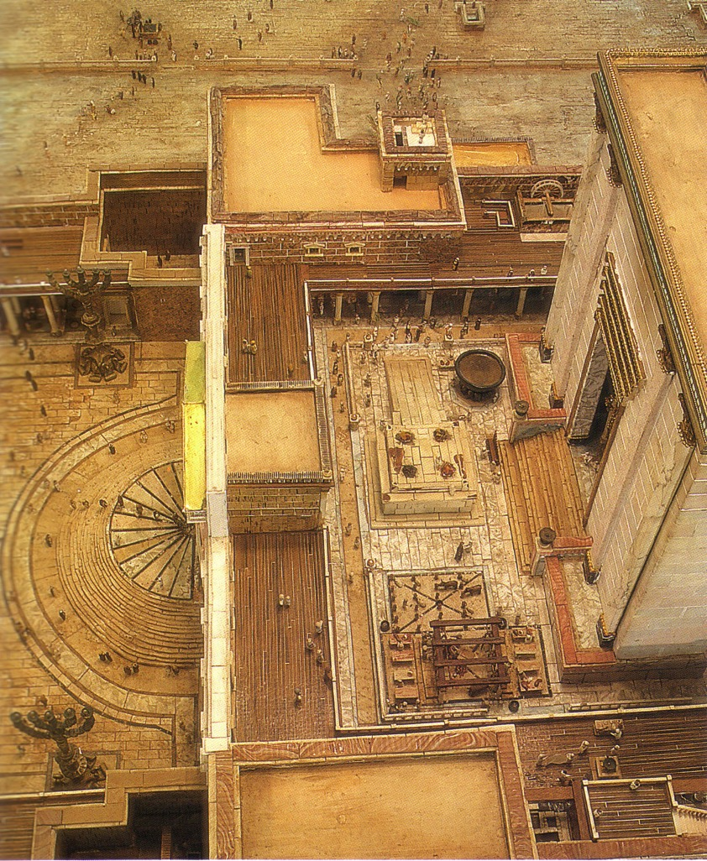
The Inner Temple Court and the steps leading to the Nicanor Gate
A+j gpuNjrj;jpy; gj;J ghpRj;j epiyfs;
Mrhhpahpd; kz;lgk;
iffis itf;Fk;> gyp nrYj;Jk;> mirthl;Lk; fhzpf;if nrYj;Jk; Mrhhpah;fSf;F kl;Lkhd ,lk;.
3MtJ kfh ghpRj;j ,lk;
Notes:
Mishnah Tractate Kelim 1.6-9 in Elwood & Yarbrough, Readings from the First Century World, 23

Slide 38
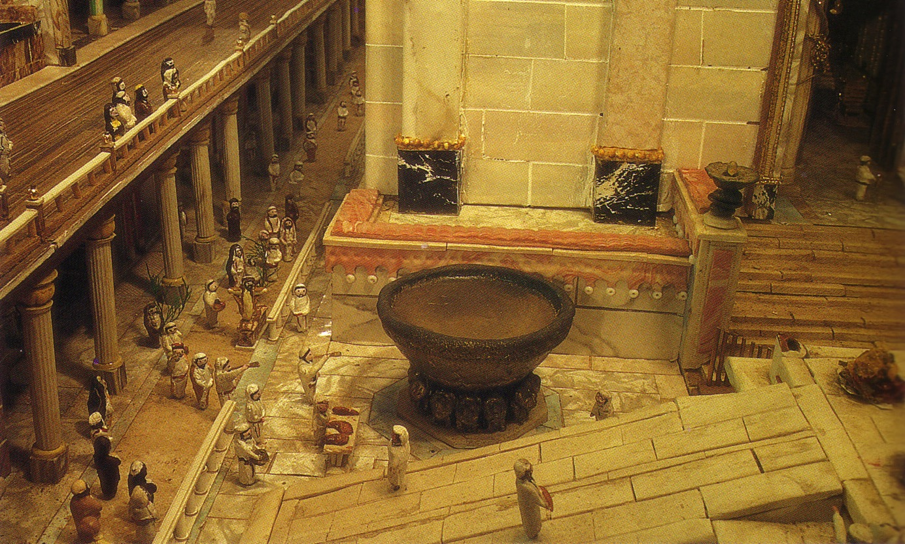
The Great Basin in the Court of the Priests.
A+j gpuNjrj;jpy; gj;J ghpRj;j epiyfs;
gypgPlj;jpw;Fk; jho;thuj;jpw;Fk; (Porch) ,ilapyhd gFjp
jPl;by;yhjtuhfTk; jiy Kbapid ,Uf;fkhf fl;b Mrhhpah;fs; jq;fs; fhy;> iffis Rj;jpfhpj;J nry;y Ntz;Lk;.
jho;thuk;
gypgPlk;
2MtJ kfh ghpRj;j ,lk;
Notes:
Mishnah Tractate Kelim 1.6-9 in Elwood & Yarbrough, Readings from the First Century World, 23

Slide 39
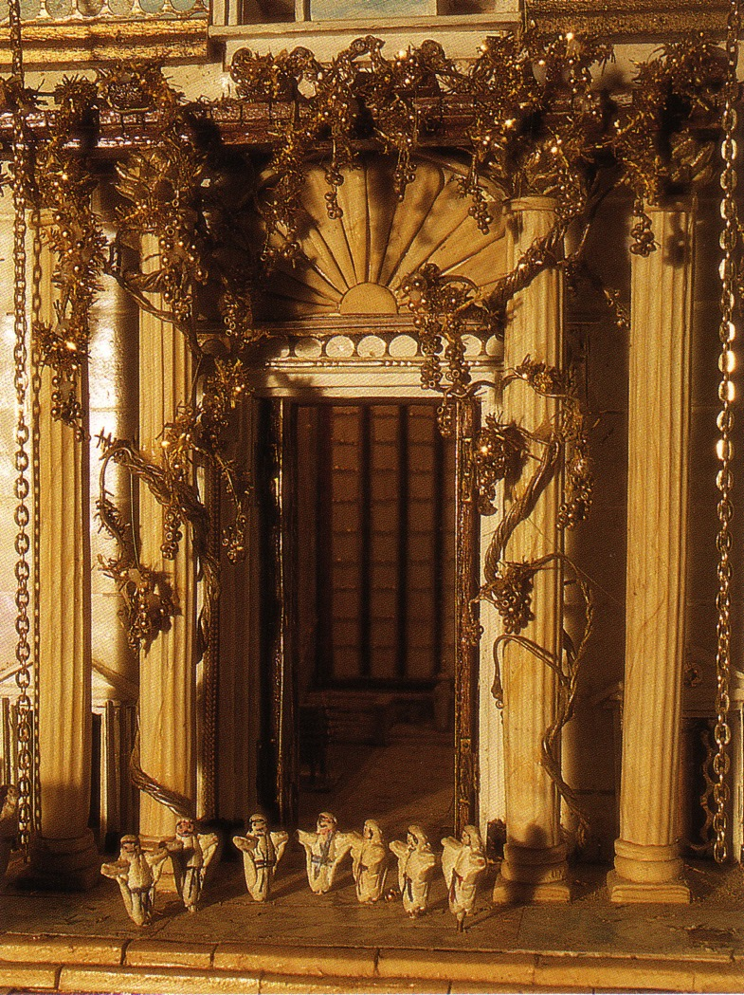
gpujhd thry;
jq;fs; fhy;> iffis [yj;jpdhy; Rj;jpfhpj;j Mrhhpah;fs; kl;Lk; ghpRj;j ];jyj;jpw;Fs; nry;y KbAk;.

Slide 40
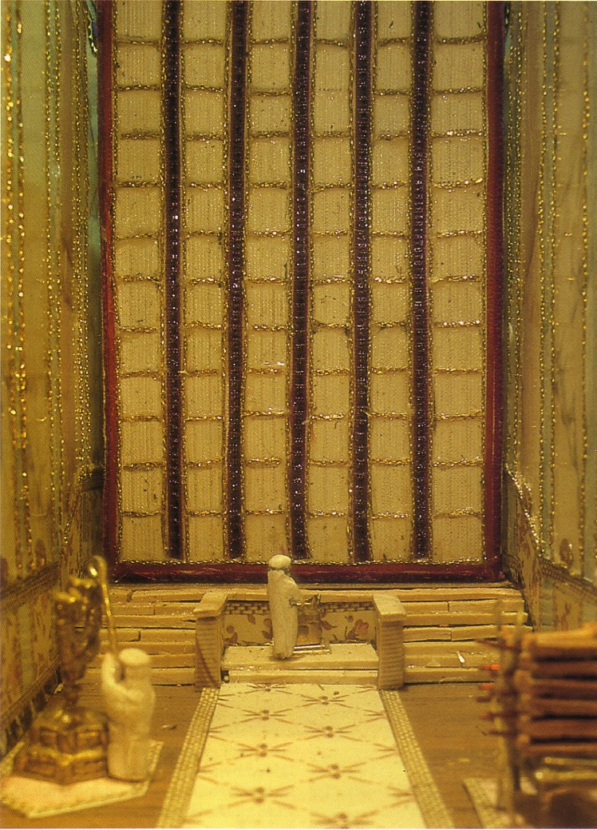
The Holy Place
Ten Jewish Levels of Holiness in the Land
A+j gpuNjrj;jpy; gj;J ghpRj;j epiyfs;
ghpRj;j ];jyk;
Only priests with hands and feet washed can enter here
ghpRj;jkhd ,lk;
Notes:
Mishnah Tractate Kelim 1.6-9 in Elwood & Yarbrough, Readings from the First Century World, 23

Slide 41
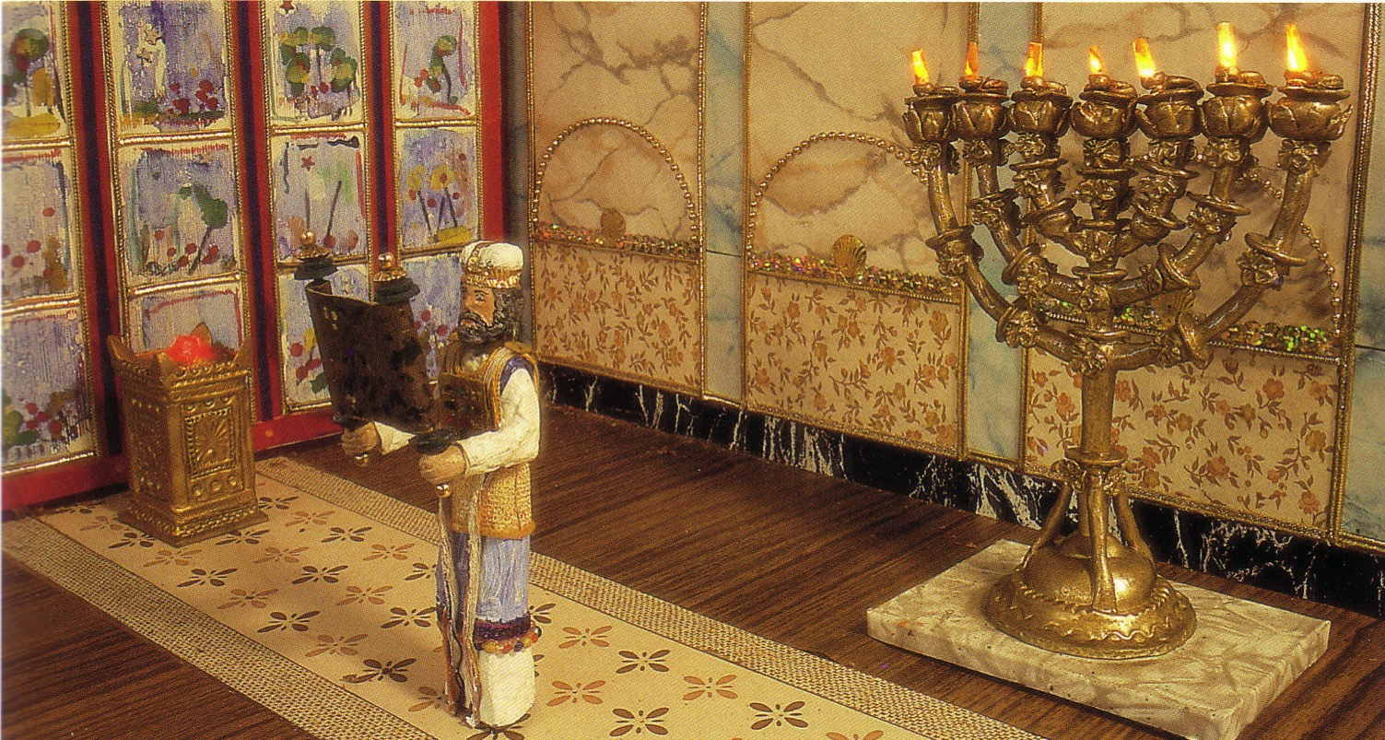
The Holy Place
Ten Jewish Levels of Holiness in the Land
A+j gpuNjrj;jpy; gj;J ghpRj;j epiyfs;
ghpRj;j ];jyk;
Only priests with hands and feet washed can enter here
ghpRj;jkhd ,lk;
Notes:
Mishnah Tractate Kelim 1.6-9 in Elwood & Yarbrough, Readings from the First Century World, 23

Slide 42
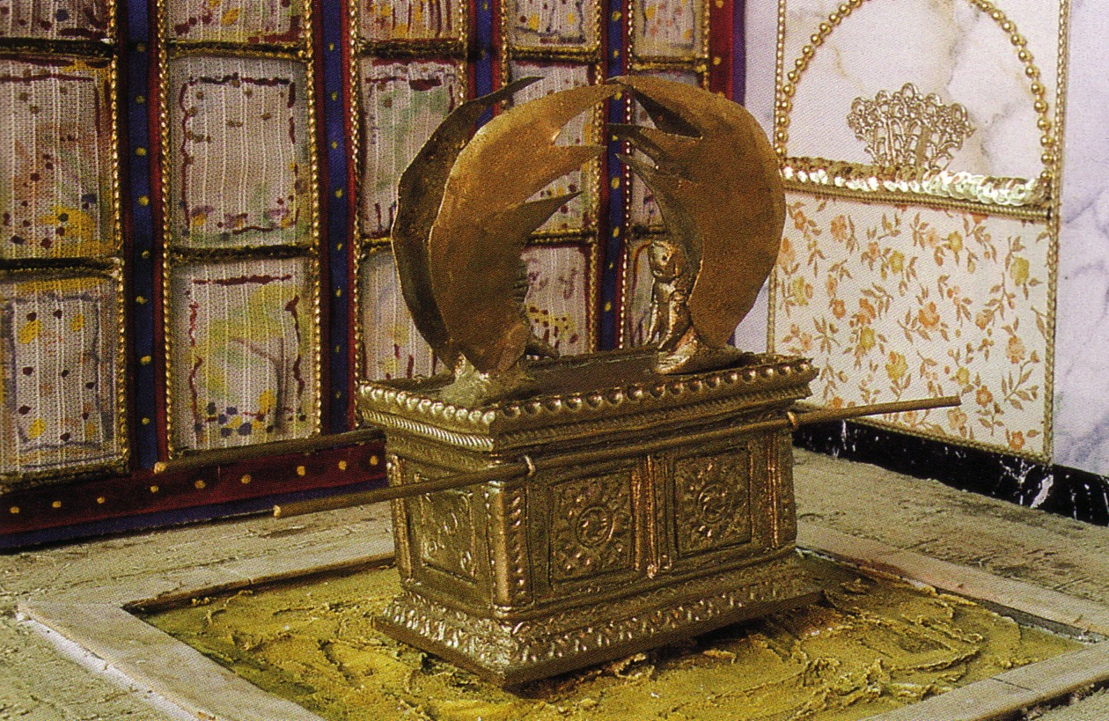
The Holy of Holies
A+j gpuNjrj;jpy; gj;J ghpRj;j epiyfs;
kfh ghpRj;j ];jyk;
tUlj;jpy; gpuharpj;jk; nra;Ak; ehspy; kl;Lk; gpujhd Mrhhpad; jpiuf;Fs; nry;y KbAk;.
kfh ghpRj;j ,lk;
Notes:
Mishnah Tractate Kelim 1.6-9 in Elwood & Yarbrough, Readings from the First Century World, 23

Slide 43
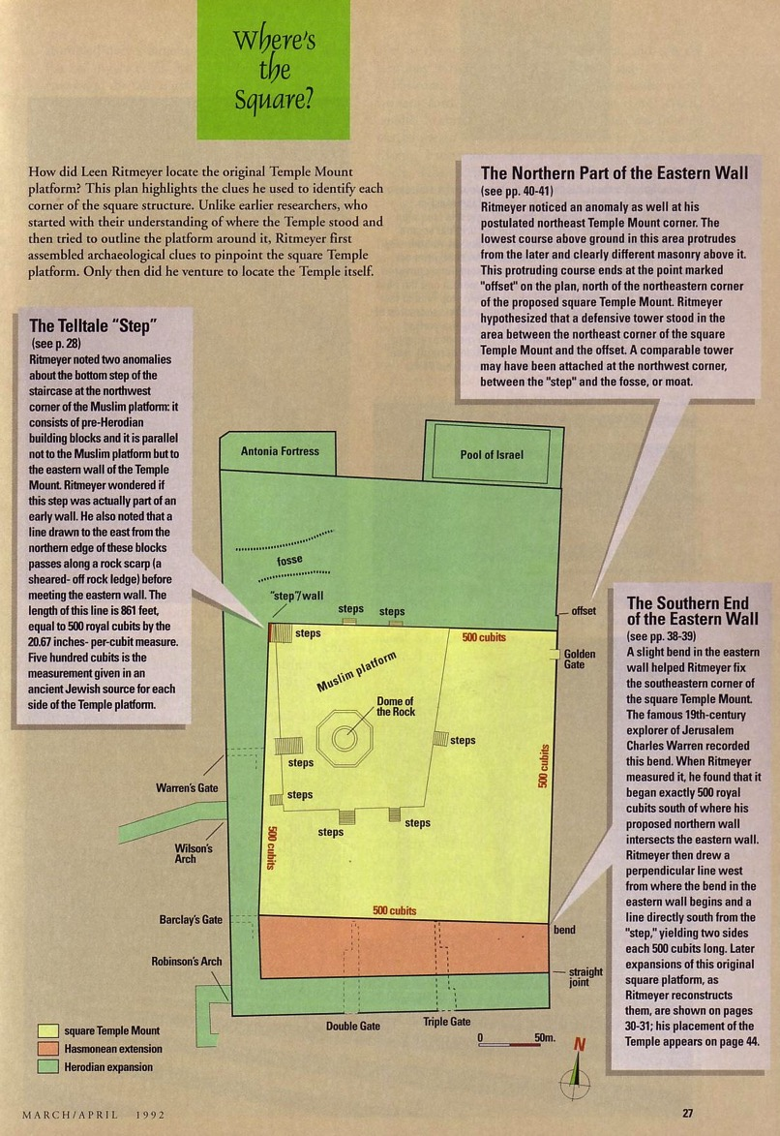
Where's the Square?
25
Mya Fd;wpid milahs gLj;Jk; ,lk;.
Biblical Archaeology Review 18 (March/April 1992): 27
Notes:
Leen Ritmeyer, “Locating the Original Temple Mount,” BAR 18 (March/April 1992): 27

Slide 44
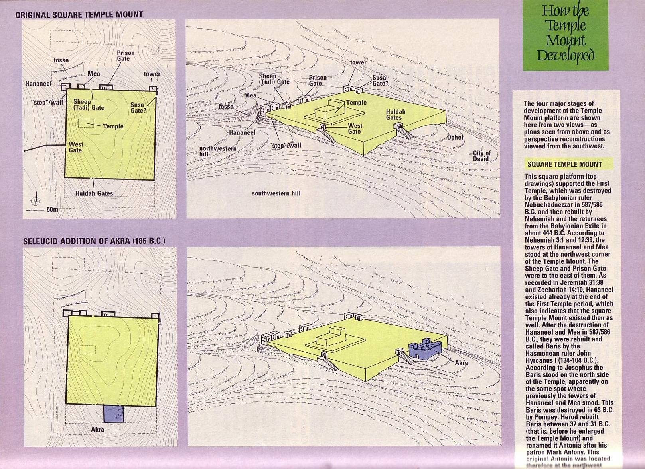
Temple Mount Stages 1-2
25
Notes:
Leen Ritmeyer, “Locating the Original Temple Mount,” BAR 18 (March/April 1992): 30

Slide 45
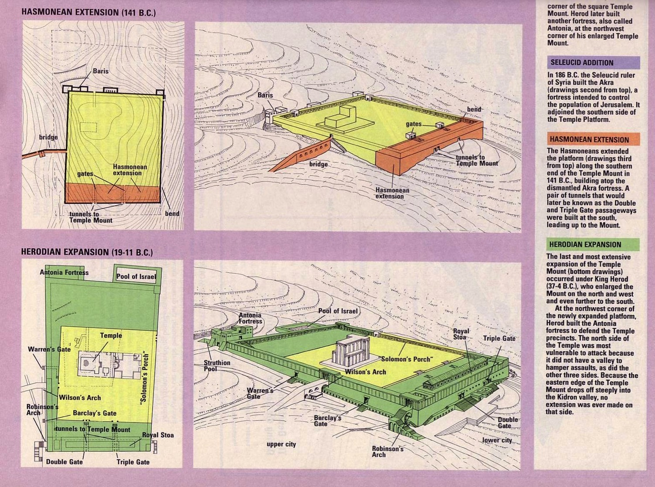
Temple Mount Stages 3-4
25
Notes:
Leen Ritmeyer, “Locating the Original Temple Mount,” BAR 18 (March/April 1992): 31

Slide 46
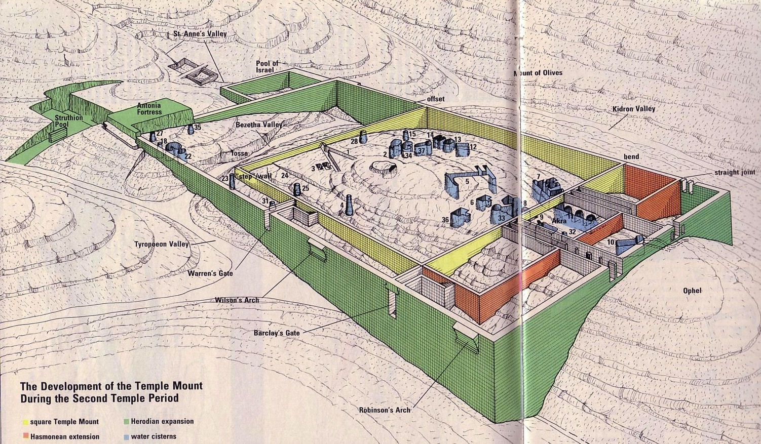
Mya Fd;wpd; mgptpUj;jp
25
Notes:
Leen Ritmeyer, “Locating the Original Temple Mount,” BAR 18 (March/April 1992): 32-33

Slide 47
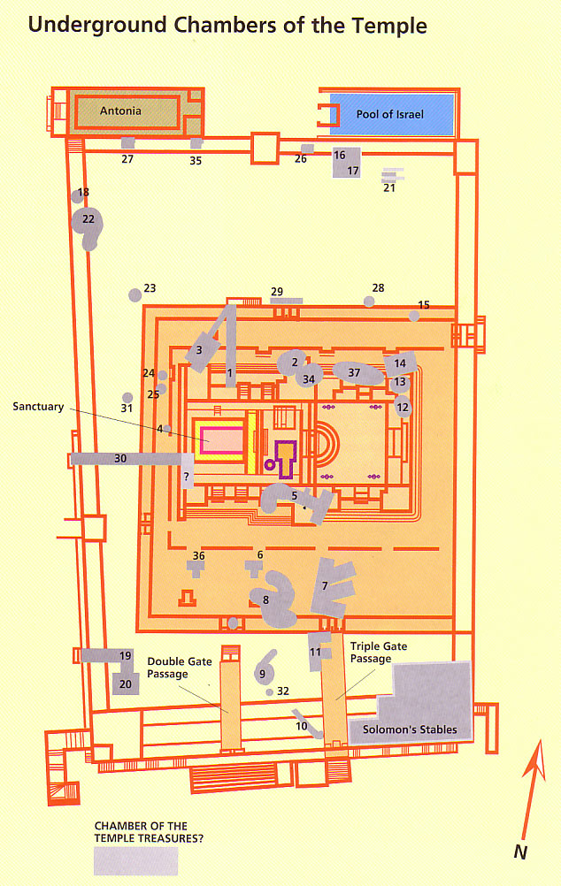
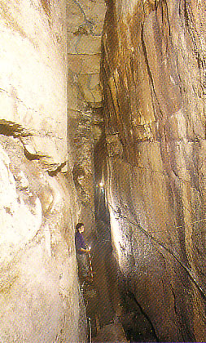
Underground Temple Chambers

Slide 48


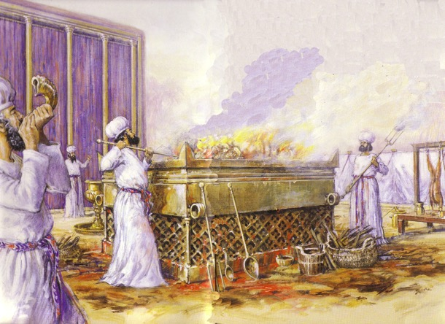
A+jhpd; fpof;F kjpy;
25

Slide 49

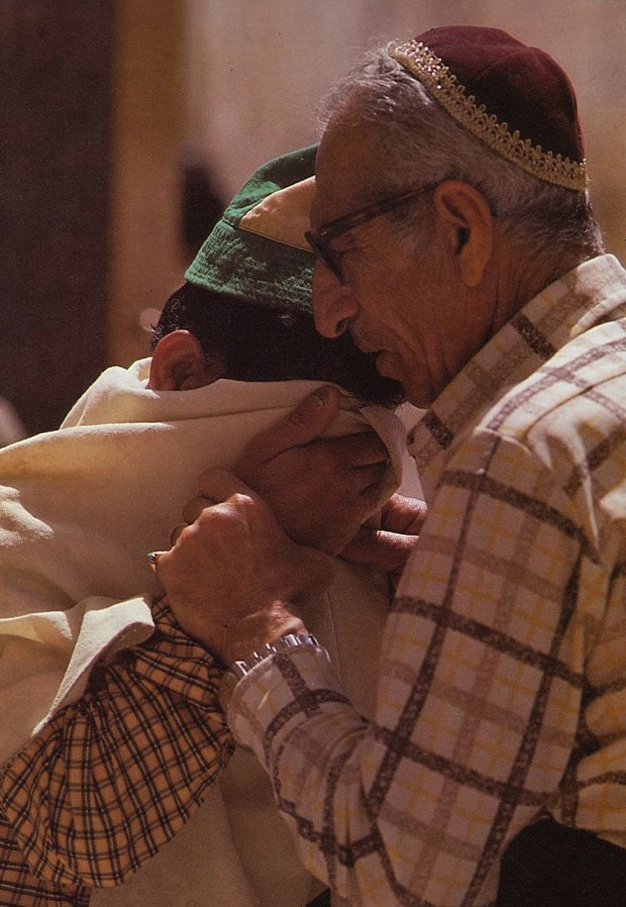
%d;whtJ Myaj;jpw;fhd n[gk;

Slide 50

etPd Mya Fd;W
25
? ? ? ?

Slide 51
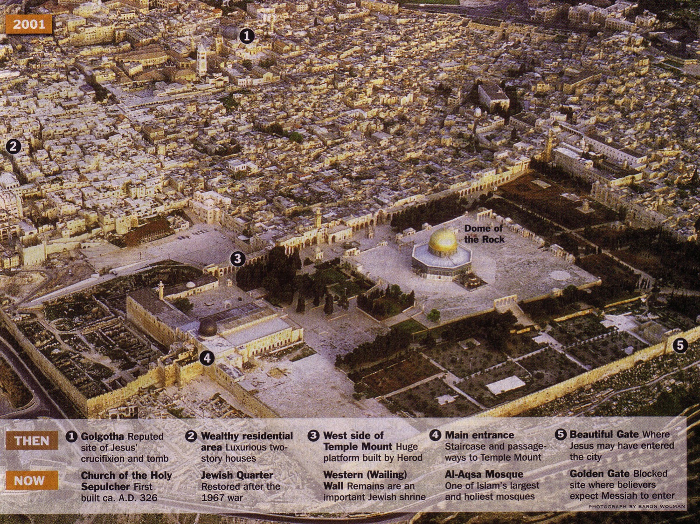

jw;fhyj;J ,];uNay;

Slide 52
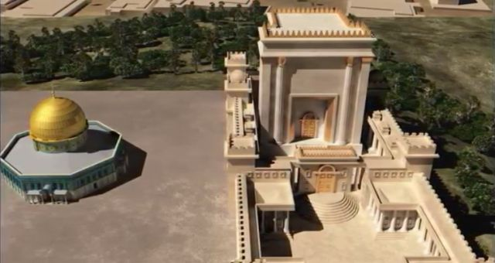
,];uNaiy me;jpfpwp];J Mjpf;fk; nrOj;Jk; 7 tUlq;fs;
79 B
,Nj Nghd;w xU mikg;ig kPz;Lkhf vUrNykpy; fl;Lthh;fs; (%d;whtJ Miyak;)
Artwork by Sunny Chandra

Slide 53
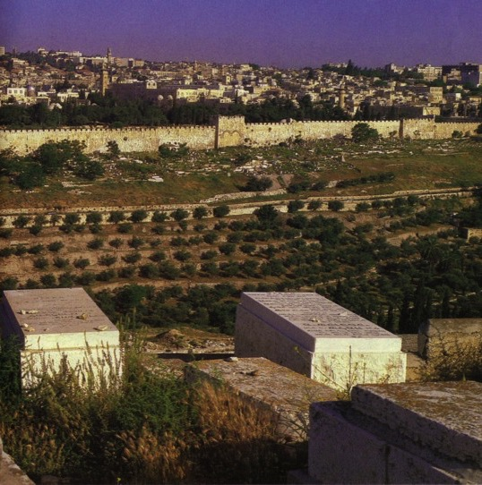
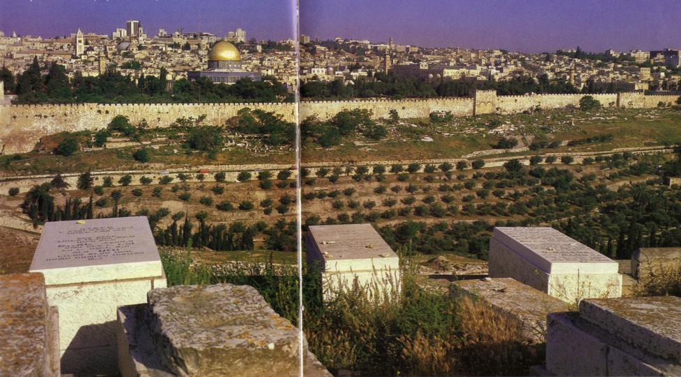
A+jhpd; capu;j;njOjiy Fwpj;j ek;gpf;if
A+jh;fs; kdpjh;fis xypt kiyapy; mlf;fk; gz;Zthh;fs;> Vnddpy; Nkrpah tUk; NghJ mtUld; Kjyhtjhf fpof;F thrYf;F nry;yKbAk; vd;w ek;gpifapd; mbg;gilapy;.

Slide 54
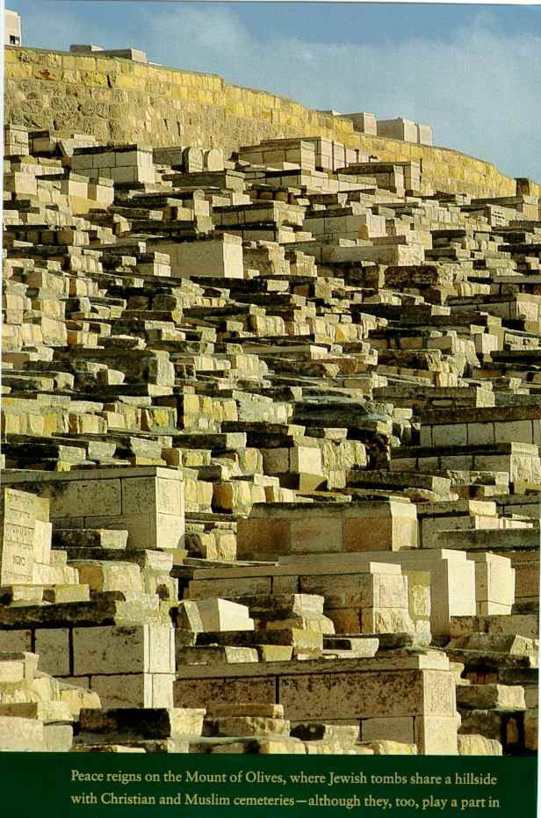
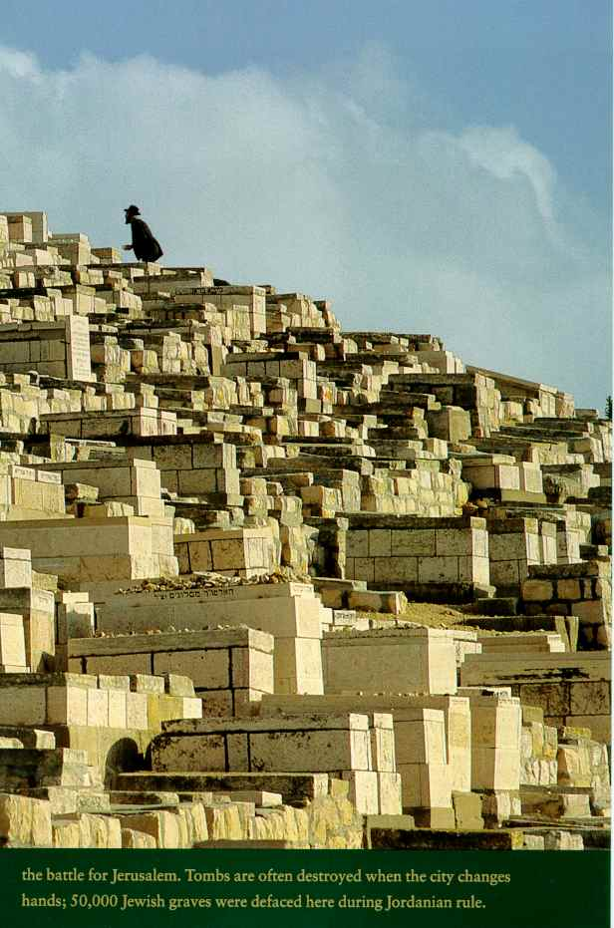
Kjy; caph;j;njOgth;fs;?

Slide 55
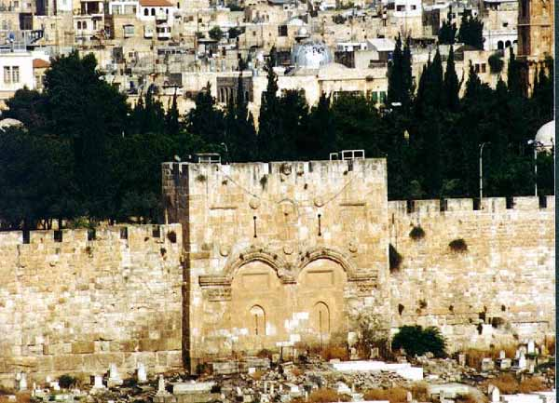
,];yhkpah; fpof;F thriy milj;J itj;Js;shh;fs;.
Notes:
This gate was blocked after the Turkish conquest of Jerusalem in AD 1517.

Slide 56
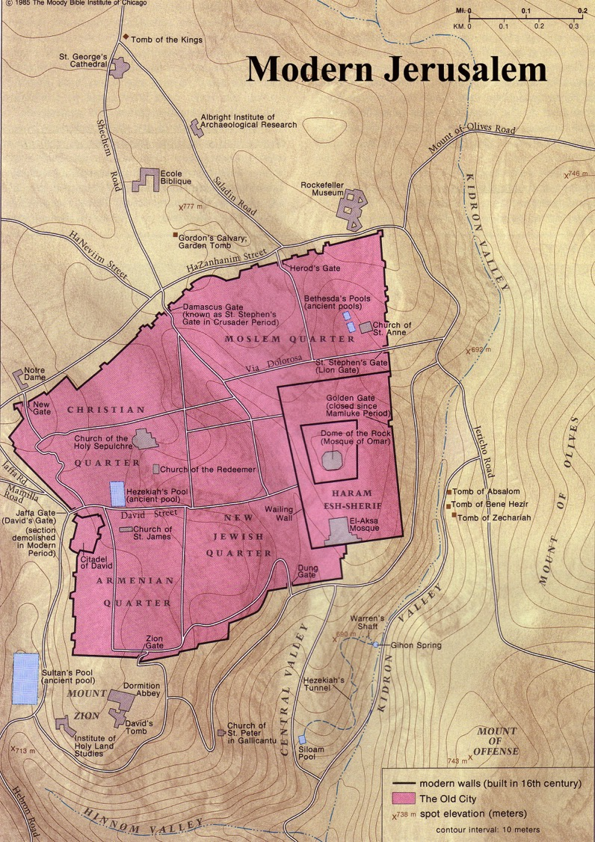
etPd vUrNyk;

Slide 57
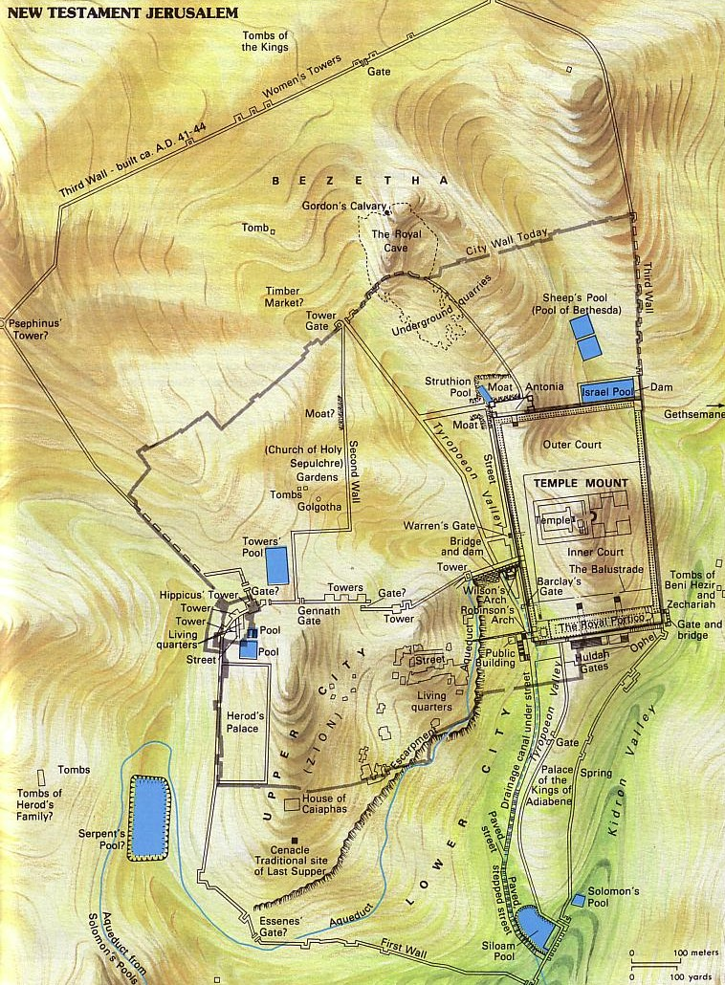
nfj;nrkNd
khw;F14:32
“gpd;G nfj;nrkNd vdg;gl;l ,lj;jpw;F te;jhh;fs;. mg;nghOJ mth; jk;Kila rP\h;fis Nehf;fp: ehd; n[gk;gz;ZksTk; ,q;Nf cl;fhh;e;jpUq;fs; vd;W nrhy;yp@
,f; FifahdJ rPNahd; kiyapy; cs;s Njhl;lj;jpy; ,Ue;J Mya Fd;W tiuAs;sJ.

Slide 58
Significance to Christians
fpwp];jth;fSf;fhd Kf;fpaj;Jtk;
fpwp];Jtpd; kuzk;
rig cUthf;fk;
jha; rig
fpwp];Jtpd;
kps;tUif
caph;njOjy;
Gjpa Vw;ghl;L vUrNyk;

Slide 59

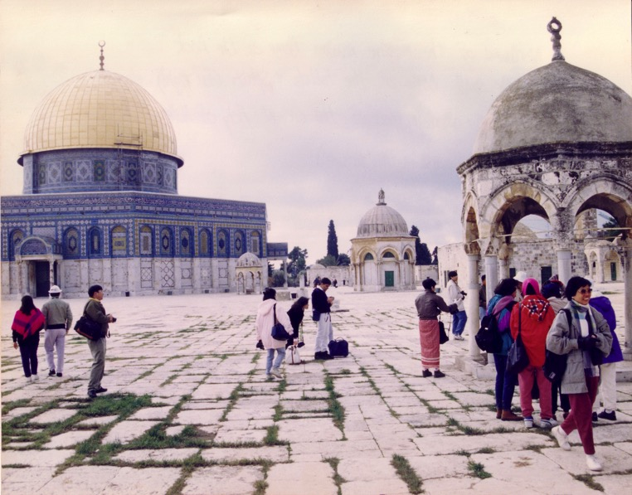

,];yhkpahpd; fl;LghL
Xkhh; gs;spthry;
(Ftpkhd fy;
Dome of the Rock)
my;-mf;rh gs;spthry;

Slide 60
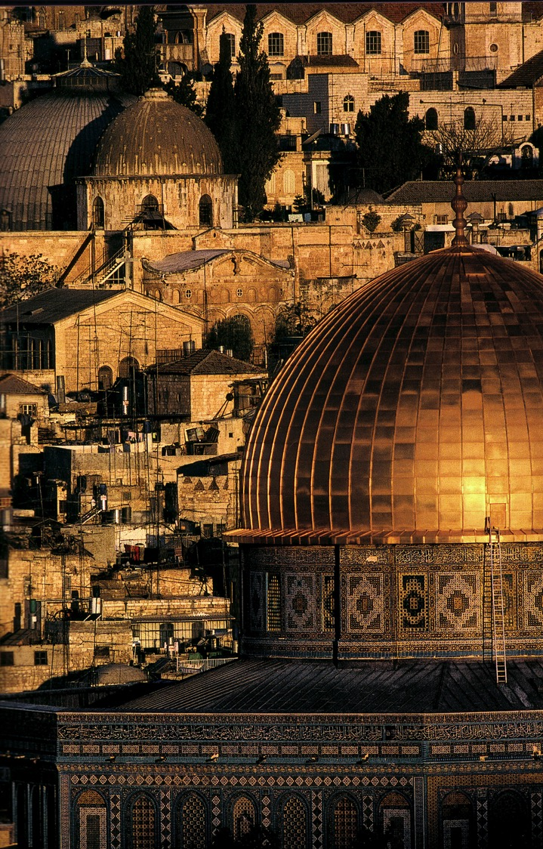
Ftpkhlj;jpw;F (Nlhk;) Gwk;Ng fhzg;gLk; Ftpkhlk;;

Slide 61
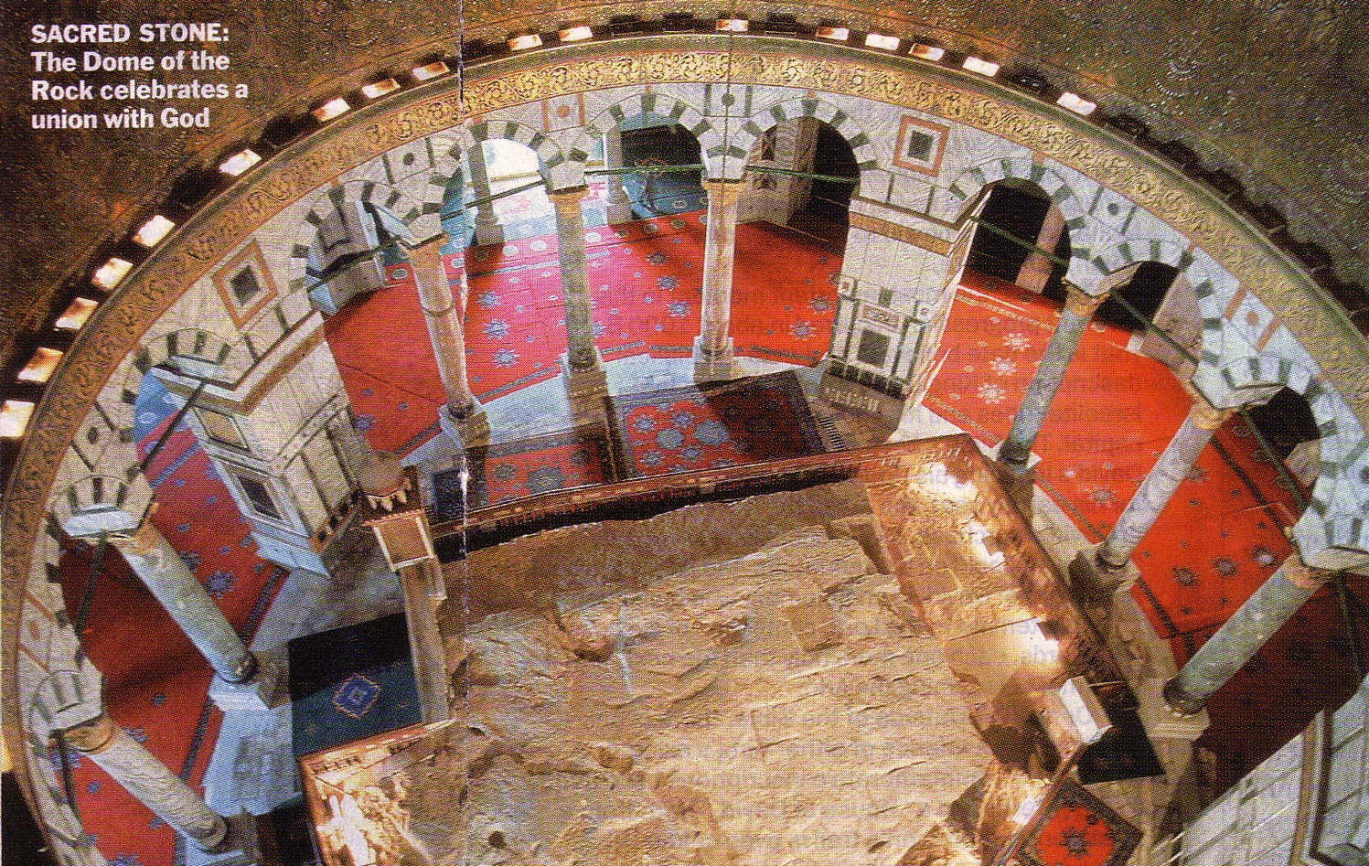
fy;ypd; cl;gFjp
Gdpj fy;: NjtDldhd [f;fpaj;ij nfhz;lhLk; ,lk;

Slide 62
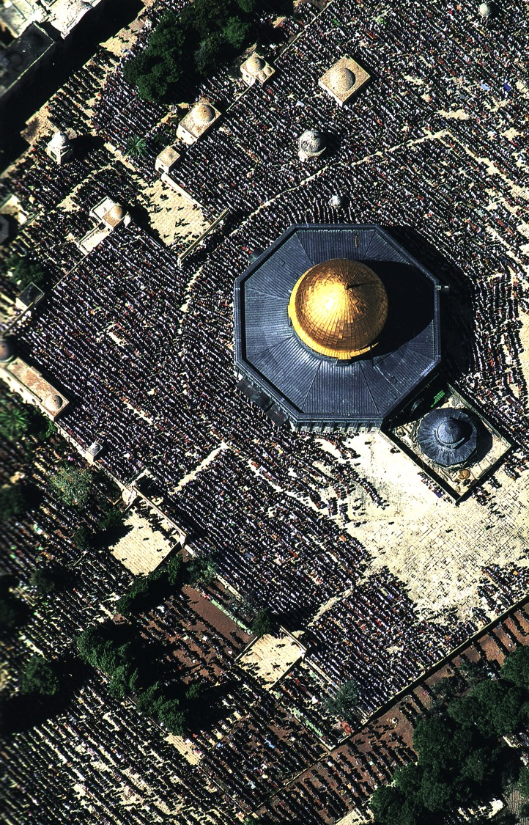
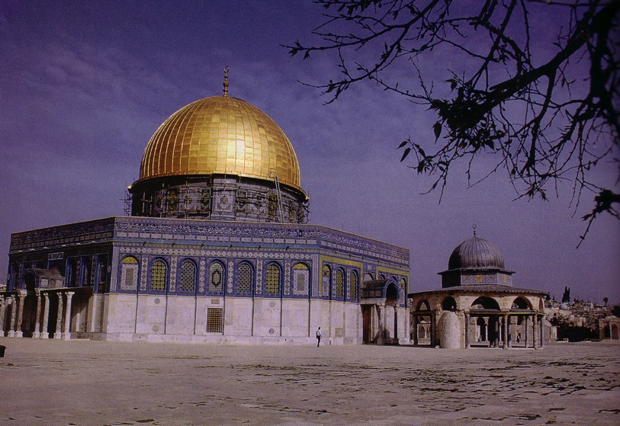
,];yhkpahpd; njhOiff;fhd Ftpkhlk; (Nlhk;)

Slide 63

jw;Nghija vUrNykpd; [dj;njhif
Nkw;F = A+jh;
Nkw;F = muhgpah;

Slide 64
vUrNyk;
(2002)
Foundation for Middle East Peace
(March 2002)

Slide 65



jw;fhy vUrNyik #o ,Ug;gth;fs;

Slide 66




Gujhd vUrNykpd; Mjpf;fk;
147g
• fpwp];jth;fs;
• ,];yhkpah;
• A+jh;
• Mh;kPdpah;

Slide 67

fpwp];jth;fspd; Mjpf;fk;
147g

Slide 68

fpwp];jth;fspd; Mjpf;fk;
147g

Slide 69
Mya Fd;wpd; jw;Nghija epiy

Slide 70

,];yhkpahpd; Mjpf;fk;
147g

Slide 71

,];yhkpahpd; Mjpf;fk;
147g

Slide 72

A+jhpd; Mjpf;fk;
147g

Slide 73

A+jhpd; Mjpf;fk;
147g

Slide 74

Mh;kPdpahpd;Mjpf;fk;
147g

Slide 75

Mh;kPdpahpd; Mjpf;fk;
147g

Slide 76

Ftpkhlj;jpd;(Dome) vjph;fhyk; vd;d?

Slide 77
kpNydpa vUrNyk;
“..rPNahdpypUe;J NtjKk;> vUrNykpypUe;J fh;j;jhpd; trdKk; ntspg;gLk;.” Vrhah2:3
Notes:
77

Slide 78


jpUkiwapd;…mbg;gil • BibleStudyDownloads.org
,g;ghlf;Fwpg;Gfis ,ytrkhf ngw;Wf;nfhs;s
Notes:
The Bible…Basically (bb)

Slide 79
Black

